Slide 1


HOW DO INSURANCE COMPANIES HANDLE THE CHALLENGES OF AN ONGOING WAR?
VYACHESLAV CHERNYAKHOVSKY
General Director of the Insurance Business Association (Ukraine)
Chairman of the Insurance Commission of the Ukrainian Society of Financial Analysts

Slide 2
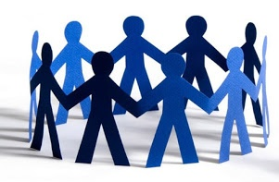
Information about the Insurance Business Association
The Insurance Business Association is an association of participants in the insurance market of Ukraine, which was established in 2004.
The Association includes 31 insurance companies. These are companies with Ukrainian capital that have been successfully operating on the Ukrainian market for a long time; there are many regional insurers among the participants.
Members of the Association are included in the management and control bodies of the MTIBU (Motor (Transport) Insurance Bureau of Ukraine), the Nuclear Insurance Pool of Ukraine.
The share of member companies of the Association in the MTPL market is 17 insurance companies in MTIBU, more than 45% of the total number of MTPL market participants.
https://insurancebiz.org

Slide 3
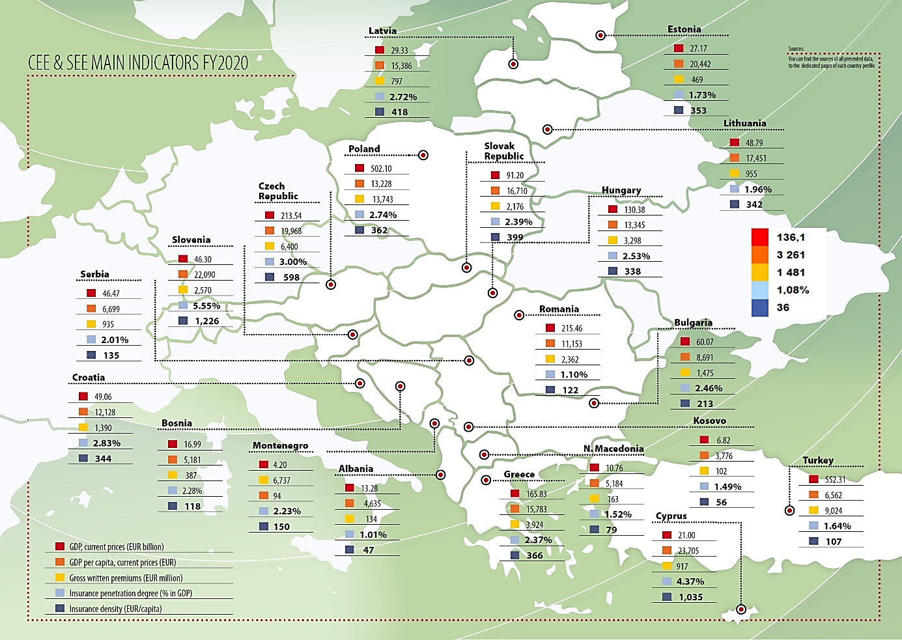
Key indicators of the insurance market of Ukraine, 2020
 | 136,1
 | 3 261
 | 1 481
 | 1,08%
 | 36

Slide 4
The share of Insurance in GDP 2011-2022 (penetration), %

Slide 5
Premiums by insurance business lines, billions UAH and USD, 2018-2022

Slide 6
Number of insurance companies in Ukraine 2020-2022, (-40%)

Slide 7
Distribution & Claims of life and non-life insurance, 2018-2022, %

Slide 8
Premiums by insurance business lines, 2022, billions UAH and %

Slide 9
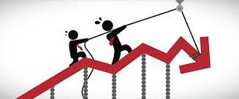
Inflation-adjusted insurance premiums, main lines (97%), 2021-2022

Slide 10

Structure of decrease in insurance premiums among the companies, 2022/2021

Slide 11
The main challenges faced by insurance companies during the war (1)
Some of the offices of companies registered in cities in the East of Ukraine and branches were damaged or even destroyed or ended up in the occupied territories
Some employees of the companies were injured during the missile and artillery attacks, drafted into the Defense Forces, some went missing or have been in the occupied territories for more than a year
In the first weeks of the war, some employees could not work normally because they had to evacuate their families to the western part of Ukraine or abroad
Employees were ready to work even from bomb shelters - but most of these structures or those that replaced them (underground parking lots, basements, subways) were generally poorly equipped and did not have the Internet
Problems with power supply, communication and the Internet (especially noticeable in the first months of the war and in the fall of 2022 and the winter 2023 during the massive missile attacks of Ukraine)

Slide 12
The main challenges faced by insurance companies during the war (2)
According to our surveys in March 2022, only 5% of companies continue to work without problems. About 60% of companies continue to work despite difficulties. Almost a third have interruptions in their operations and can only work partially. Almost 10% of companies cannot continue to operate.
This year most insurance companies operating in the Ukrainian market have managed to stabilize their activities
However, I have to mention that companies are leaving the market - not only because of the consequences of the war but also because of excessive and redundant regulatory requirements

Slide 13
What have been helping to keep the business running?
General stress resistance: we live in the country where various crises occur regularly
Remote work skills: as a result of the Covid-19 pandemic, the national insurance business was well adapted to remote work at the time of the war. We had experience not only in daily, operational activities online, but even in holding shareholders' meetings, meetings of the Association's members and MTIBU members remotely
High overall level of digitalisation in Ukraine: for example, many people have electronic digital signatures, even individuals, which allows for remote document flow

Slide 14
What specific steps have been implemented
Business associations appealed to the NBU with a proposal to temporarily ease regulatory requirements, in particular in terms of reporting and imposing penalties for violations
Companies that were closest to the regions of active hostilities partially or completely relocated employees to safer regions of the country or abroad
Moving servers to a safe location and transferring key information to cloud storage
Digital settlement was implemented as actively as possible, in particular, temporarily significantly simplified requirements for documents certifying the occurrence of an insured event
It was necessary to give way to document flow standards in the direction of its simplification

Slide 15
The role of the insurance industry in postwar recovery
The role of insurance will be one of the most important, as investors and investments will only come in if there is insurance protection, including against military and political violence risks
People's living standards have fallen during the war, and therefore the ability to insure against significant financial losses will be important

Slide 16
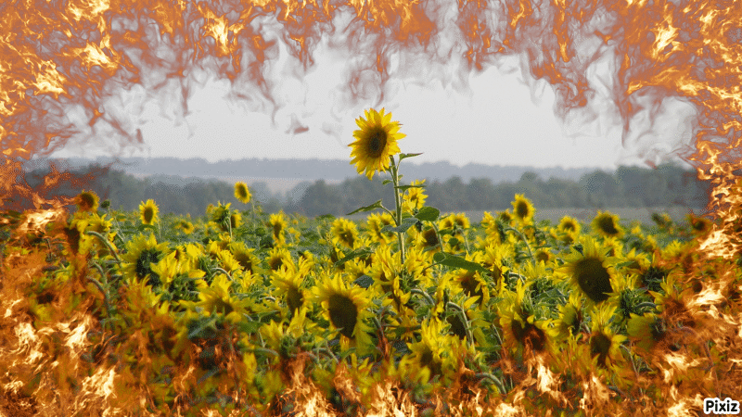
The role of the insurance industry in postwar recovery
According to our estimates, only 4-5 years after the end of the war, the insurance market will return to the level of 2021
We are doing everything possible to enable the national insurance market to develop
new types of insurance
confidence in insurance
regulatory policy

Slide 17
The way of securing the business of any country in case of war (1)
At the strategic level:
Governments should provide clear information and forecasts-signals to businesses in the event of a military threat (to avoid what happened in Ukraine with the President's promise of "barbecue for the May holidays"). This will enable companies to be adequately prepared to different scenarios
Response plan at the level of the industry regulator on general issues: paying taxes, submitting reports, conducting audits during the wartime, etc.

Slide 18
The way of securing the business of any country in case of war (2)
At the level of certain companies:
Business digitalization, remote and distributed team skills
At least basic energy independence of offices
Duplication of all key business information in cloud services, including on servers in other countries
Systematic, daily backup of information
Creation and work out crisis scenarios with staff in advance – it can be not only a military threat, but also a natural disaster/ terrorist attack

Slide 19
Thank you for your attention
Ready to answer your questions

